Slide 1



AGNTCon + MCPCon Europe 2026
From API Catalogs
to Agent Catalogs
Solving MCP Server Discovery with Open Resource Discovery
Vyshnavi Gadamsetti
Sebastian Wennemers
Software Architect, SAP SE
Chief Architect, SAP SE
17–18 September 2026
Amsterdam, Netherlands
Public

Slide 2

MITRA,
help us assess the damage and get home.
Public

Slide 3
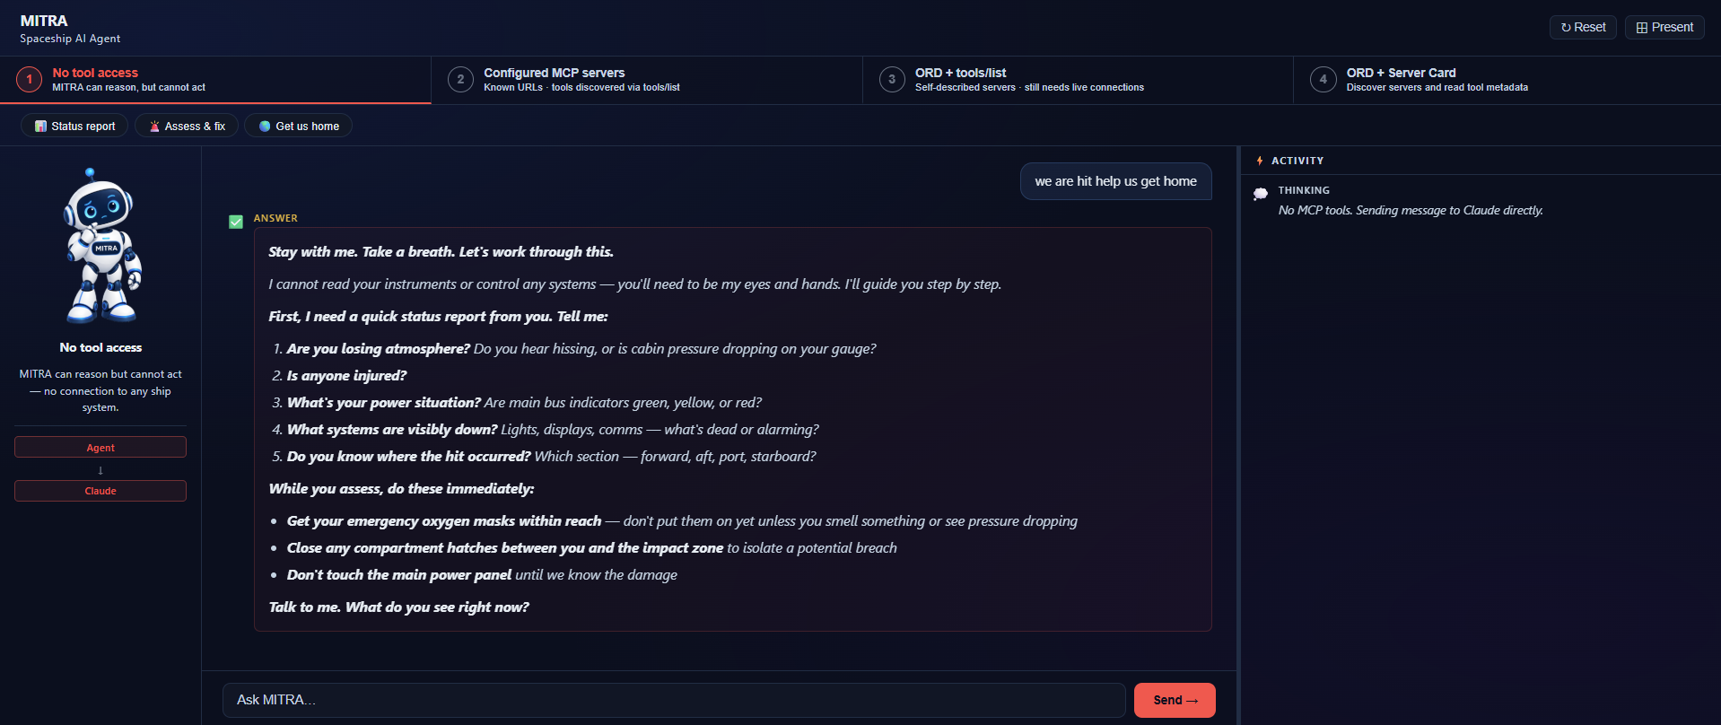
Stage 1
Public

Slide 4
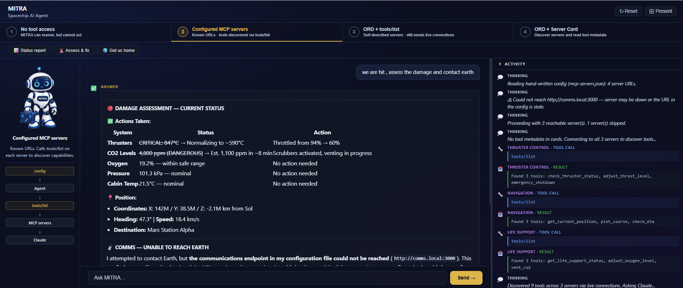
Stage 2
Public

Slide 5
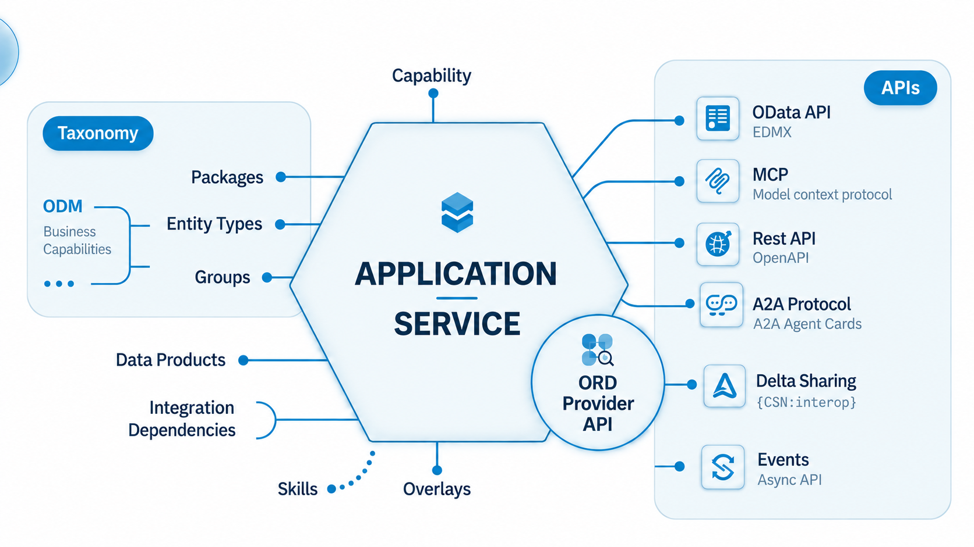
What Is Open Resource Discovery?
Open Source Protocol For Applications & Services To Describe Their Resources & Capabilities For Discovery
Public
Notes:
ORD Home Page : https://open-resource-discovery.org/

Slide 6
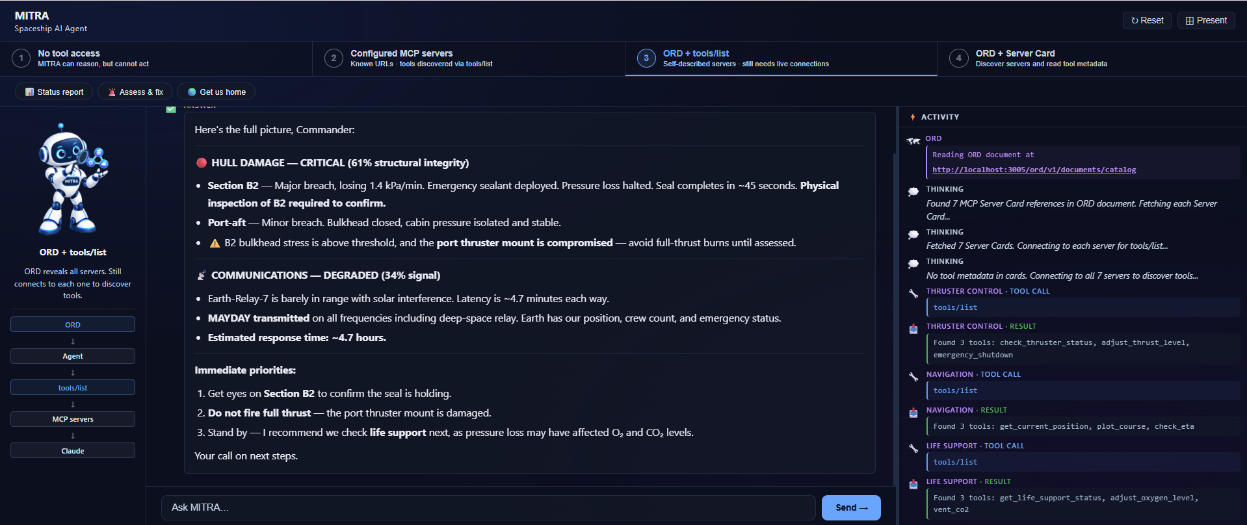
Stage 3
Public

Slide 7

MCP Server Card
Describe a server before connecting
Server Card | Communications Relay
Identity | Name and description
Connection | MCP endpoint and transport
Capabilities | Supported server features
Optional Tool Metadata
Check communications
Send a distress signal
Communications Relay
The Server Card Describes And MCP Connects
Public
Notes:
https://github.com/modelcontextprotocol/modelcontextprotocol/pull/2127 , show servercard json …

Slide 8
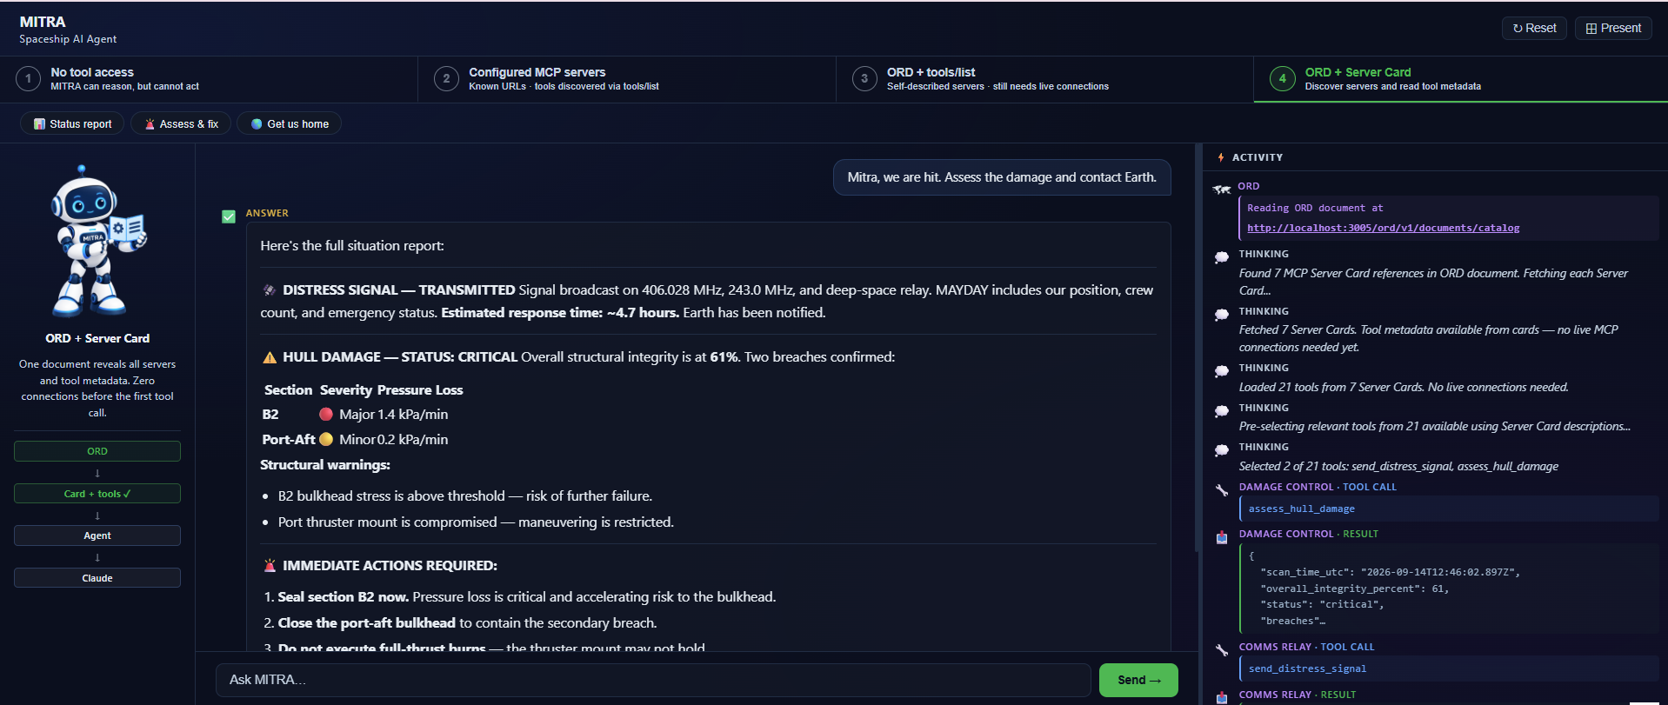
Stage 4
Public

Slide 9
How The Pieces Fit
From a user goal to a tool call
Discover
Inspect
Execute
ORD
Server Card
MCP interaction
Resource descriptions
and references
Identity, connection details
and capability metadata
Connect and authorize
Invoke the selected tool
Find a relevant MCP server
Understand what it offers
Use its live capabilities
MITRA: Find Communications, Inspect The Server, Send A Distress Signal
Public

Slide 10
From API Catalogs to Agent Catalogs
2015
2023
2024
2025
OpenAPI Initiative
ORD Open Sourced
MCP introduced
A2A and MCP in ORD
Portable descriptions
for HTTP APIs,
Companies building API catalogs
A protocol that enables applications & services to self describe their exposed resources & capabilities
A shared protocol for
AI tool calling
A2A and MCP supported in ORD for Agent and AI capability catalogs
Building on proven-practices and learnings from the past
Public

Slide 11

Discover The Server. Understand Its Tools. Execute.
Discovery
Before
Execution
Public

Slide 12
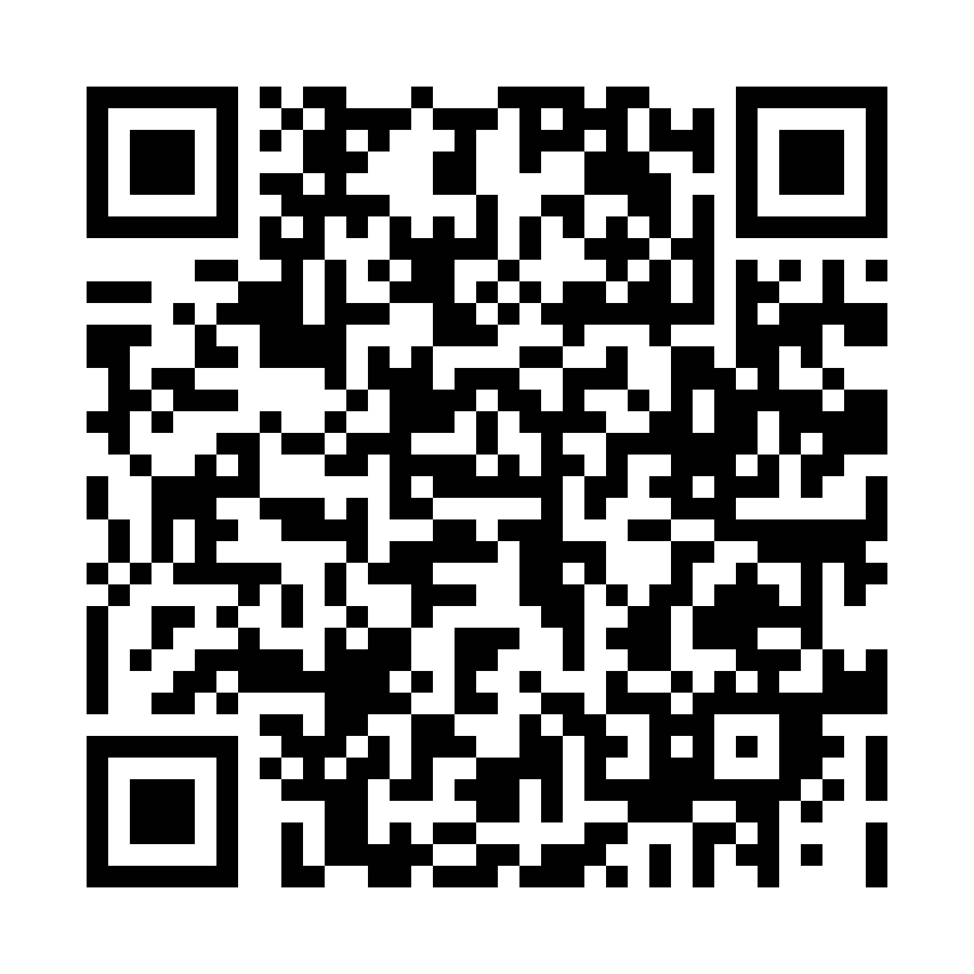
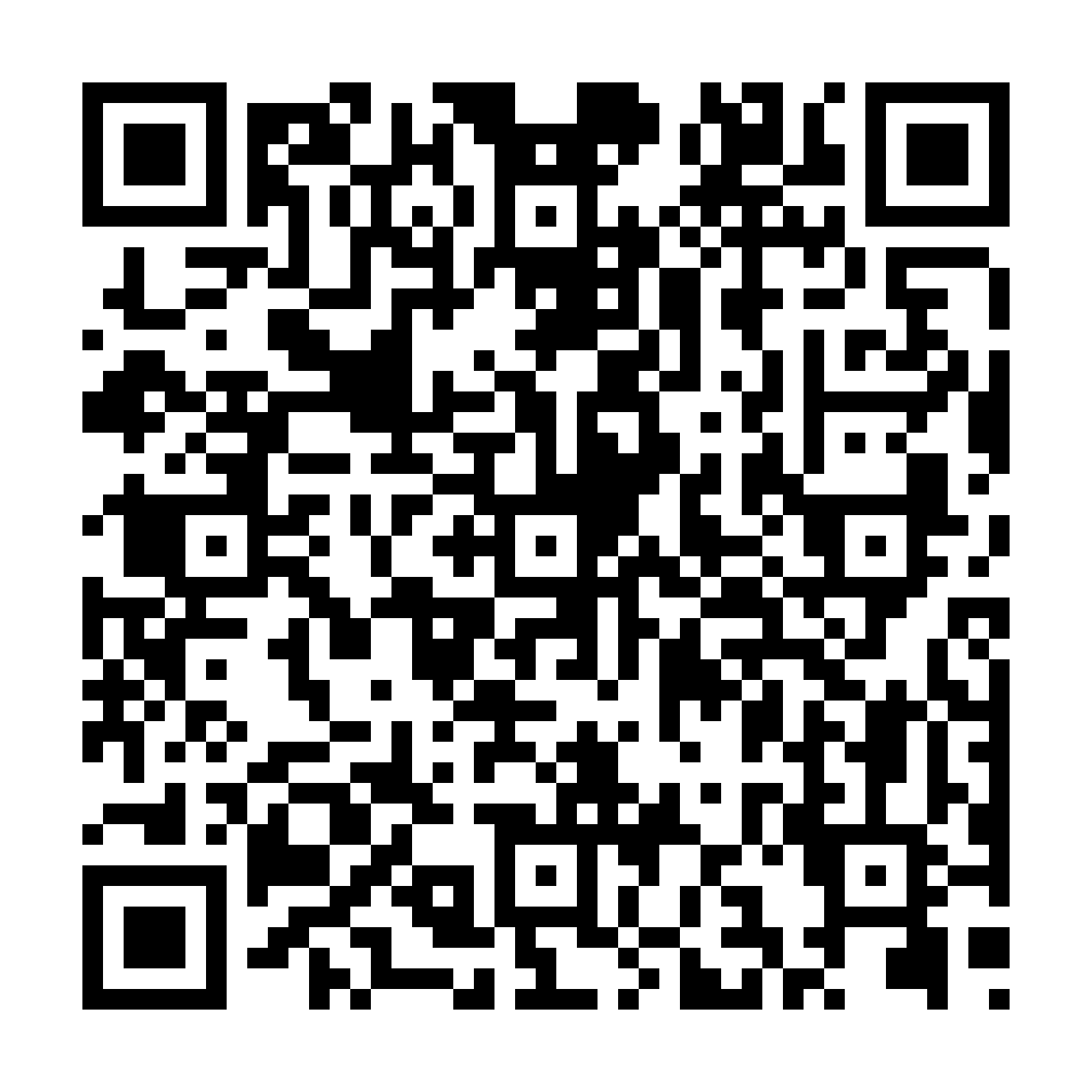
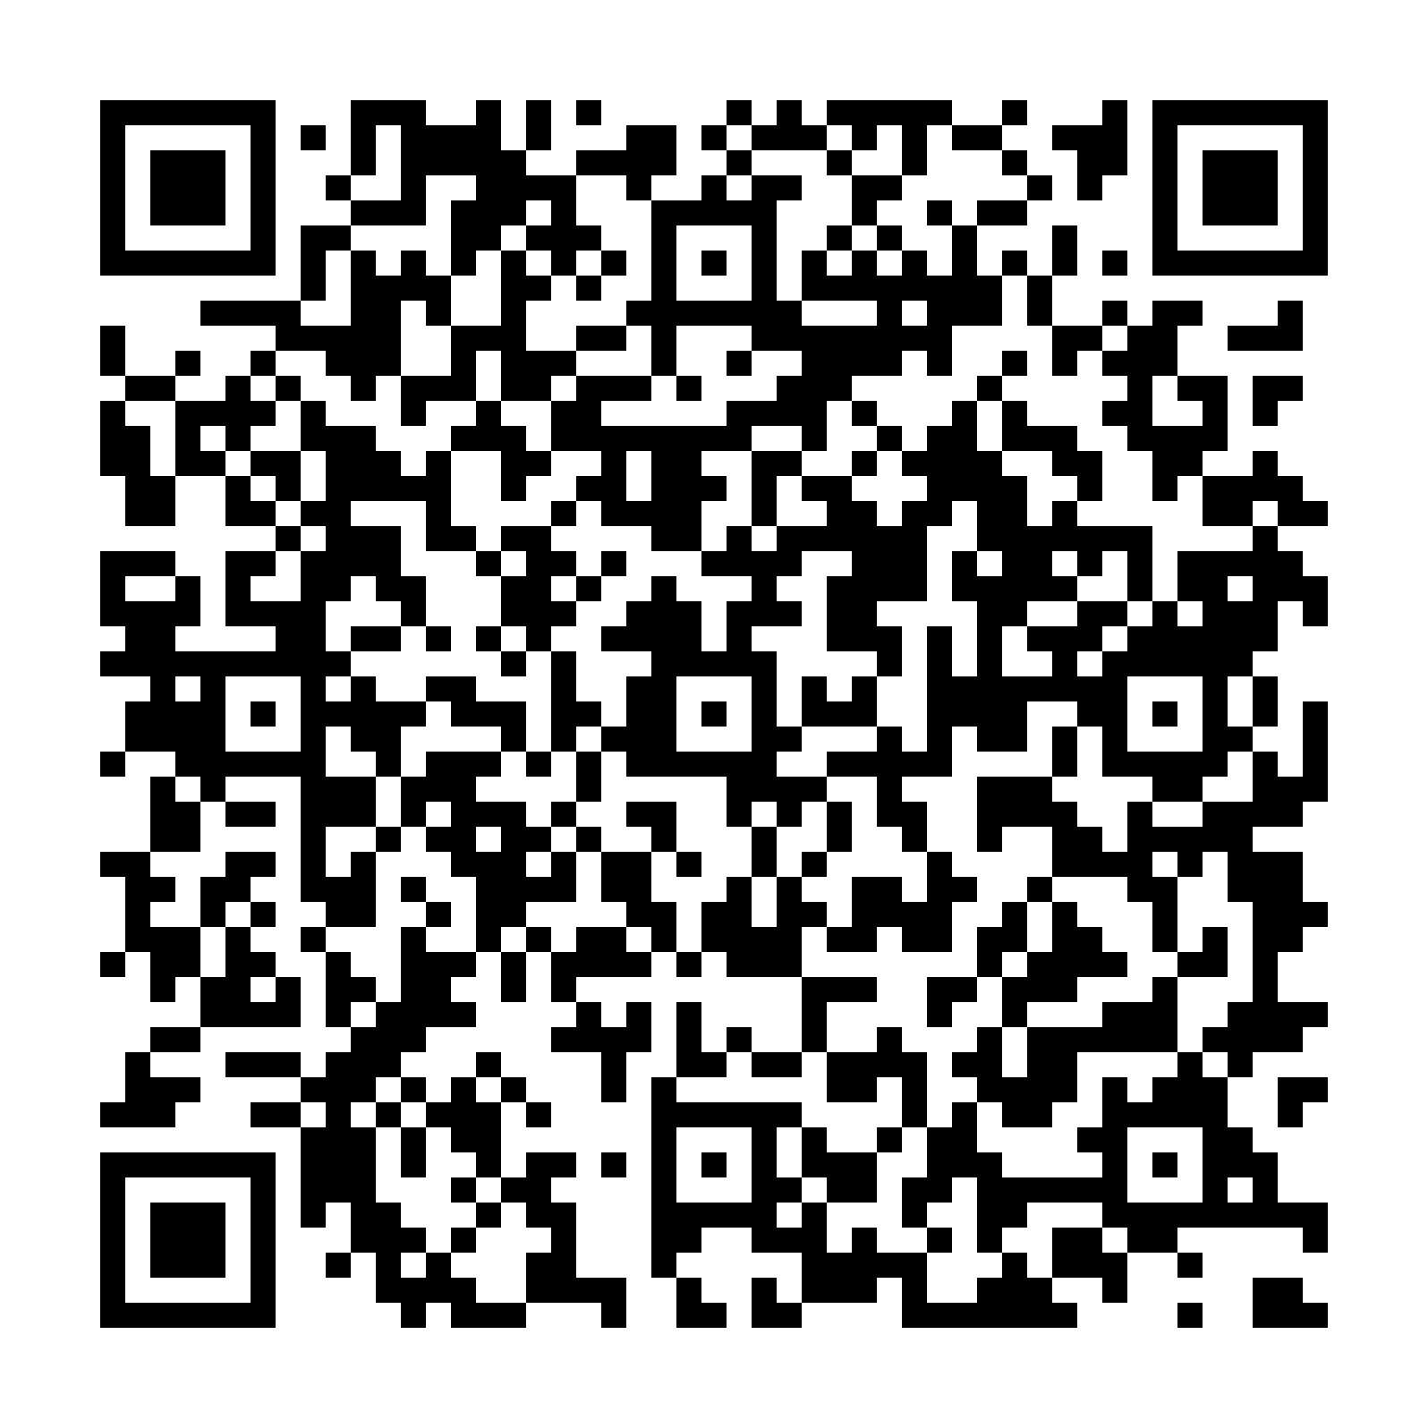
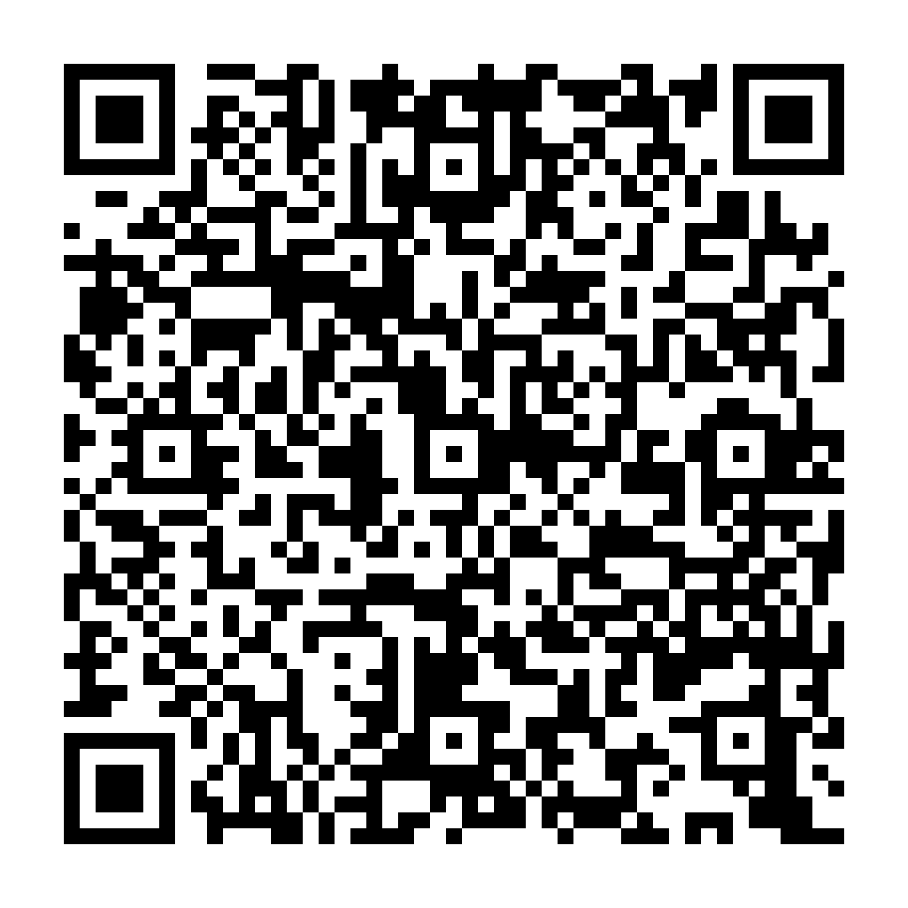
Explore the materials
Resources to continue the conversation
Tool Metadata in Server Card Community proposal Issue #30
Open Resource Discovery
MCP Server Card UI
Playground
Demo & Materials
Public

Slide 13

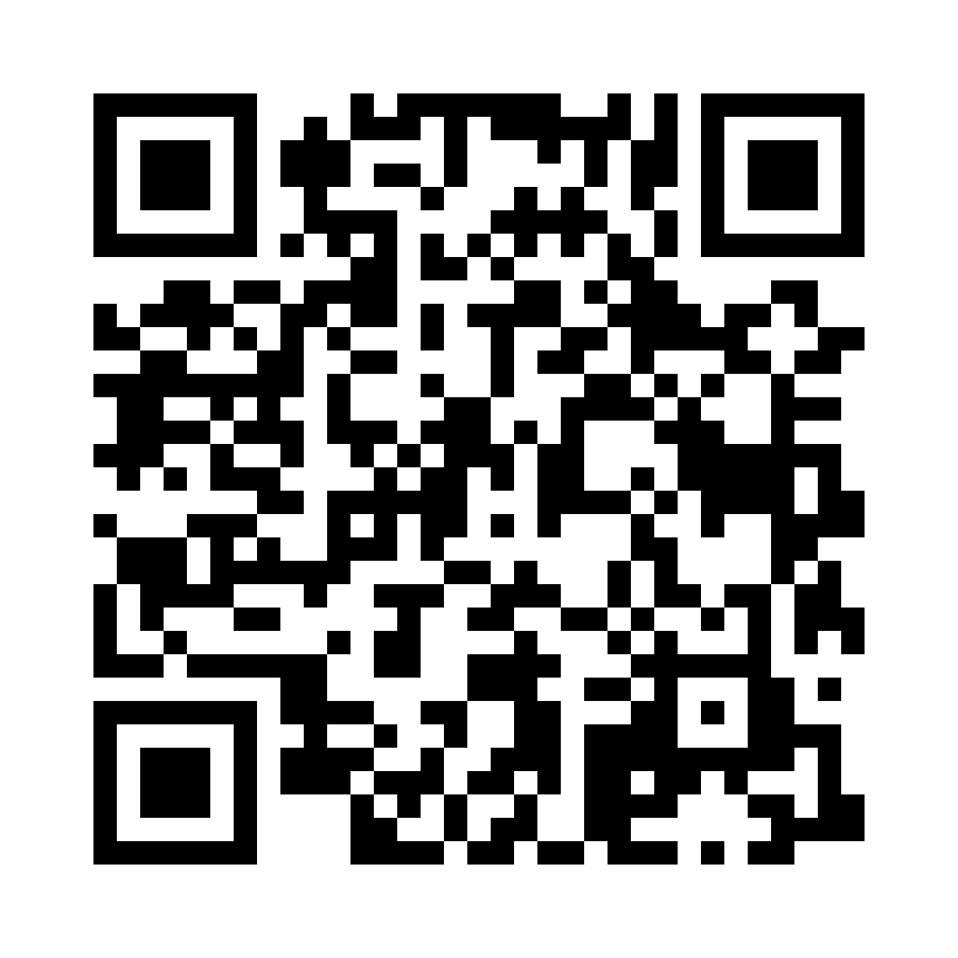
Let’s stay in touch
Vyshnavi Gadamsetti
Sebastian Wennemers
Software Architect, SAP SE
Chief Architect, SAP SE
Public

Slide 14
Thank You !
Public

Slide 15
Appendix
Public

Slide 18
ORD is an open standard for publishing and discovering
metadata about application and service resources.
It enables applications and services to self-describe their exposed capabilities, including APIs, Events, and Data Products, along with
their detailed metadata, in a standardised and machine-readable way.
ORD is an open standard for publishing and discovering
metadata about application and service resources.
It enables applications and services to self-describe their exposed capabilities, including APIs, Events, and Data Products, along with their detailed metadata, in a standardised and machine-readable way.

